Slide 1

Debugging Tests for Model Explanations
Md Mahfuzur Rahman
TReNDS, GSU, GATech, Emory University

Slide 2
Model:
Class-specific logit:
Explanations broadly fall under two categories:
Sensitivity Methods (Gradient Methods/Saliency Maps)
Perturbation Based Approaches (Model Agnostic), also called feature importance.
Other methods include rule based, counterfactual explanations etc.
Explanation – Common Approaches
Ancona et al. 2019

Slide 3
Gradients:
Integrated
Gradients:
Explanation – Common Approaches

Slide 4
Smooth-Grad:
Smooth-Grad
Squared:
Var-Grad:
Explanation – Common Ensemble Approaches

Slide 5
Deep Taylor Decomposition
Layer-wise Relevance Propagation (LRP)
Excitation BP
PatternAttribution
Deconv
RectGrad
Guided BP
Modified Backpropagation (Signal Methods)

Slide 6
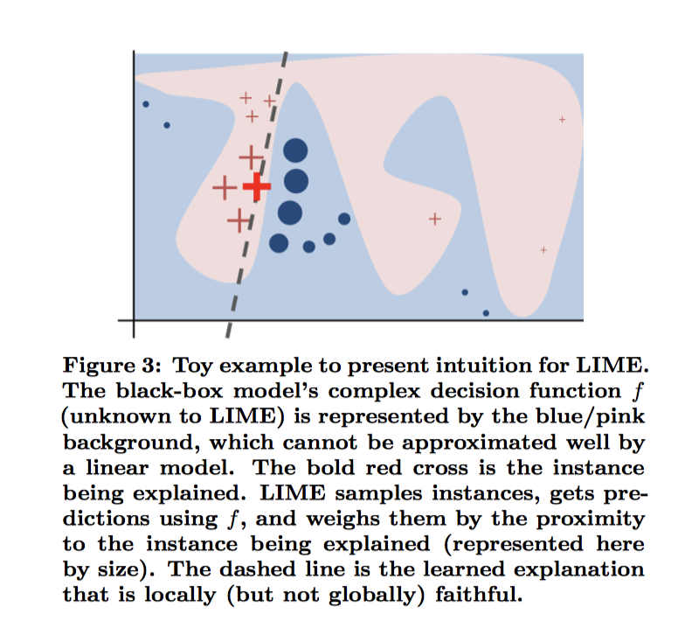
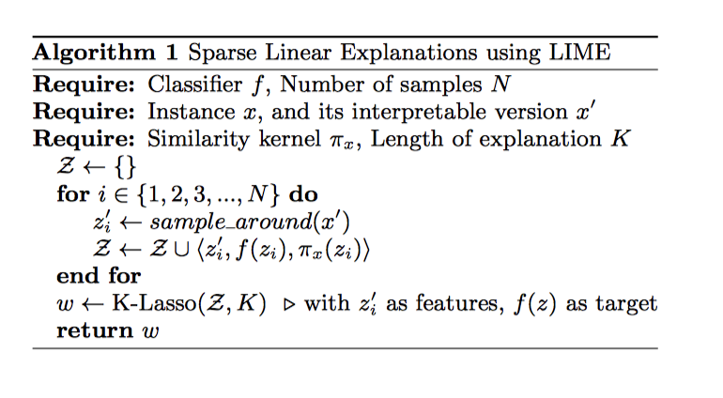
Perturbation Approaches
Ribeiro et al. 2016

Slide 7
SHAP computes the marginal contribution of each input dimension to the output score:
Uses random permutation.
Start with a baseline and adds features according to permutation.
Repeat 1 and 2 for multiple times and then average.
Perturbation Approaches
Lundberg et al. 2017

Slide 8
should an explanation work equally well for diagnosing mislabeled training samples and detecting spurious correlation artifacts?
Should an explanation that is sensitive to model parameters also be eﬀective for detecting domain shift?
Are they able to express how model is thinking?
Is it possible for human to predict about next prediction based on model attributions?
Are they seeing the things that we usually don’t care about?
Do they provide any domain-level useful knowledge ?
Are we evaluating them based on our perception of what they should see?
Are Explanations Useful?

Slide 9
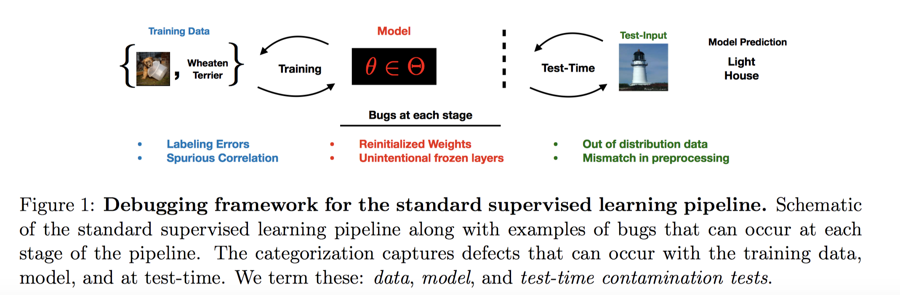
Which explanation methods are eﬀective for which classes of model bugs?
Let’s check if they can debug

Slide 10
Contributions
Bugs Categorization – where exactly it is happening? Data, Model, Test?
Empirical Assessment - assess several feature attribution methods against 4 bugs: ‘spurious correlation artifact’, mislabelled training examples, re-initialized weights, and out-of-distribution (OOD) shift.
Insights
- Feature attributions can identify a spurious background bug
- Can’t conclude about mislabelled or normal training examples.
- Modified BP are invariant to higher layers
- Attributions for out-of-distribution examples are visually similar.
Human Subject Study – a 54-person IRB-approved study was conducted
- Given the attributions and predictions from a model, human rely on predictions!

Slide 11
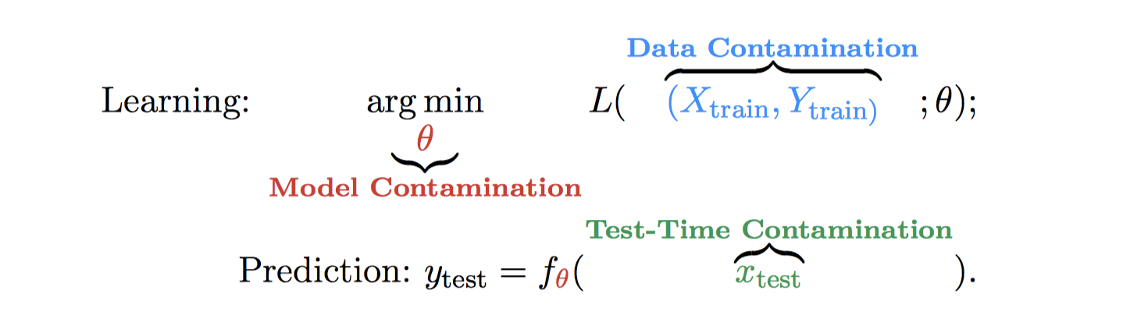
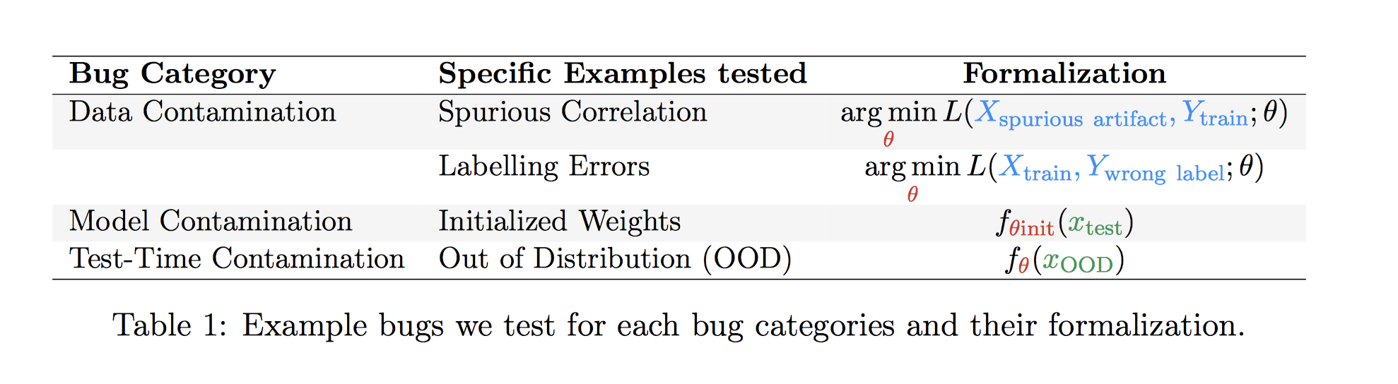
Characterization of Bugs
model bugs as contamination in the learning and/or prediction pipeline that causes the model to produce incorrect predictions or learn error-causing associations.

Slide 12
Task: birds-vs-dogs binary classiﬁcation task.
Dog sources: Cats-v-Dogs dataset
Bird sources: Caltech-UCSD dataset Architecture: A CNN with 5 convolutional layers and 3 fully-connected layers (BVD-CNN)
Test Accuracy: 94% on the model trained on dog vs cat dataset.
Architecture and Datasets

Slide 13
Dogs: Place the dogs onto a bamboo forest background.
Birds: Place the birds onto a sky background.
BVD-CNN trained on this data achieves a 97 percent accuracy on a sky-vs-bamboo forest test set (without birds or dogs)
Interpretation: The model indeed learned the spurious association.
Spurious Bug Implementation

Slide 14
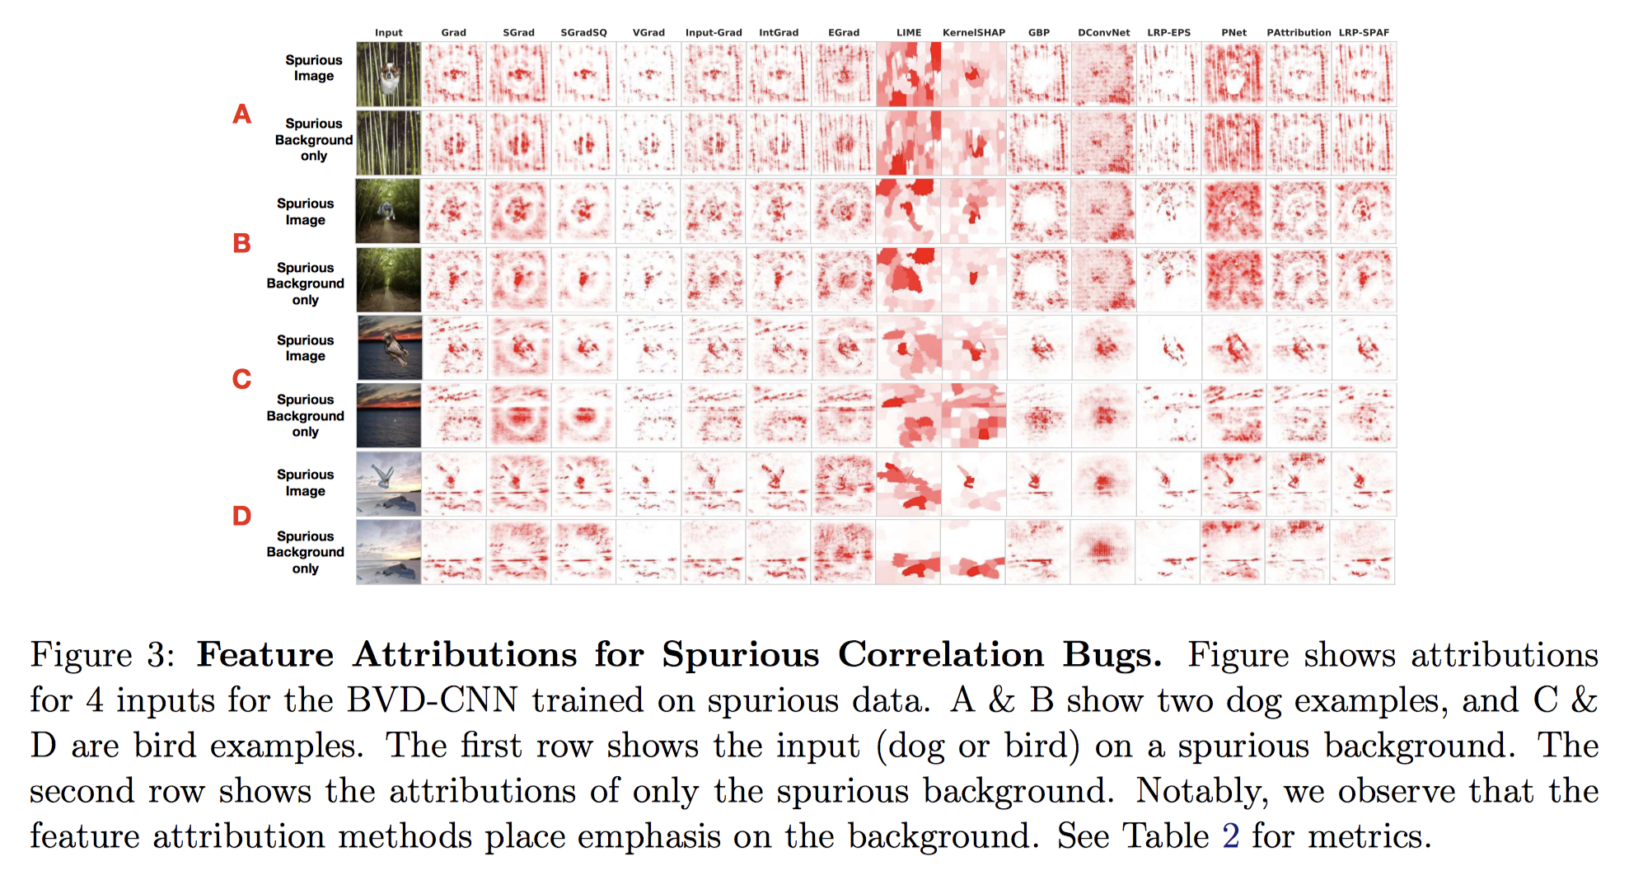
Spurious Bug Detection

Slide 15
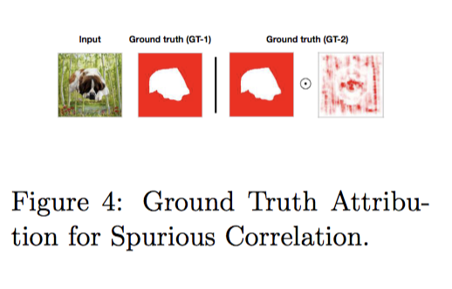
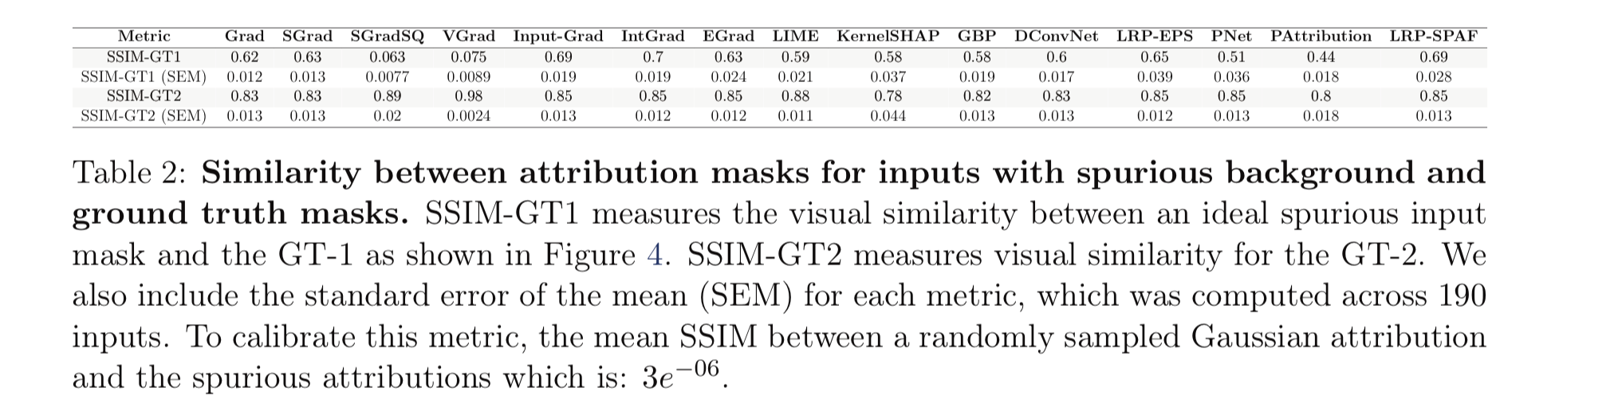

Slide 16
Participants were asked to act as a quality assurance (QA) tester for a hypothetical company that sells animal classiﬁcation models, and were shown the original image, model predictions, and attribution maps for 4 dog breeds at a time. They then rated how likely they are to recommend the model for sale to external customers using a 5 point-Likert scale, and a rationale for their decision. Participants chose from 4 pre-created answers or ﬁlled in a free form answer.
Human Study

Slide 17
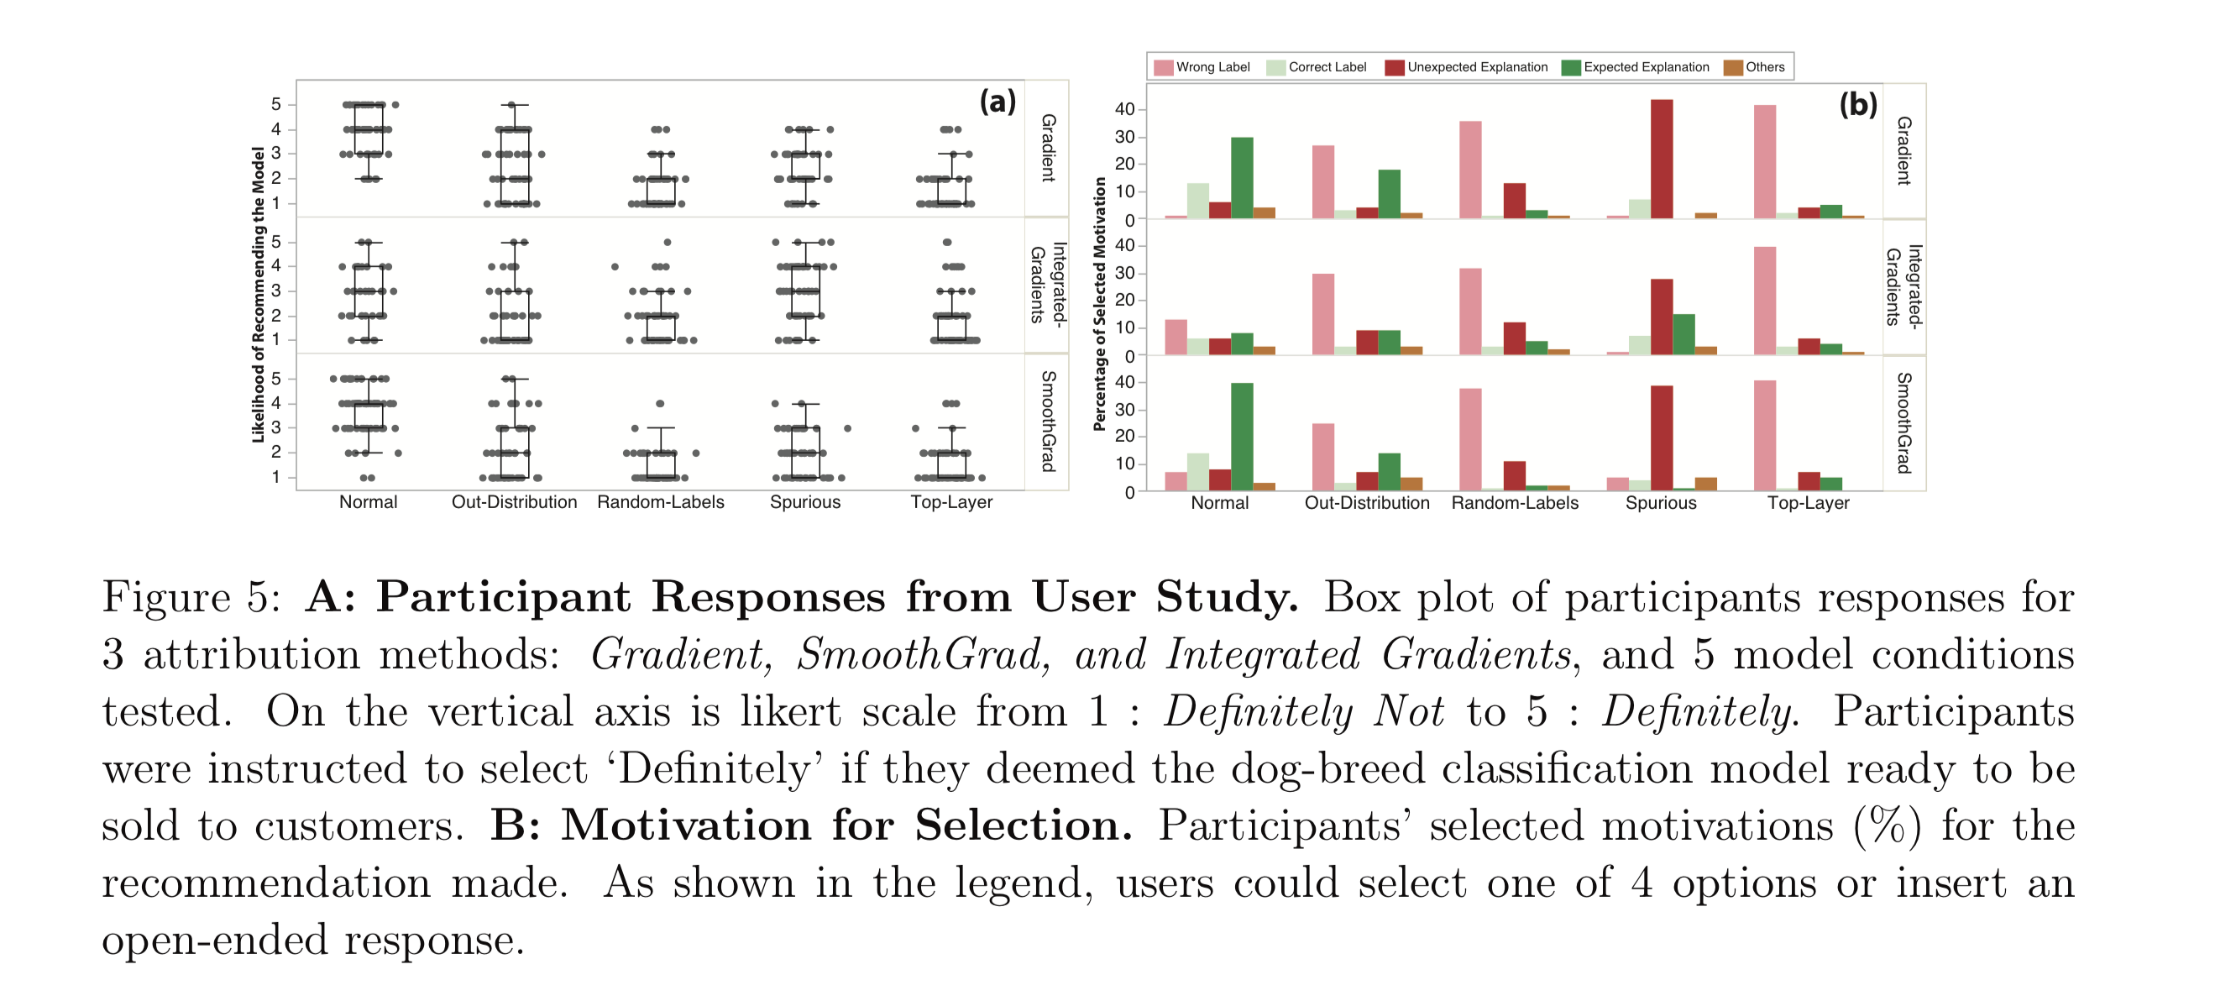
Summary from Human Study

Slide 18
We train a BVD-CNN model on a birds-vs-dogs dataset where 10 percent of training samples have their labels ﬂipped. The model achieves a 93.2, 91.7, 88 percent accuracy on the training, validation, and test sets.
Mislabelled Examples

Slide 19
For mislabeled examples, this paper compares attributions for a training input derived from: 1) a model where this training input had the correct label, and 2) the same model settings but trained with this input mislabeled. It was observed that attributions for mislabeled examples, across all methods, show visual similarity.
Mislabelled Examples

Slide 20
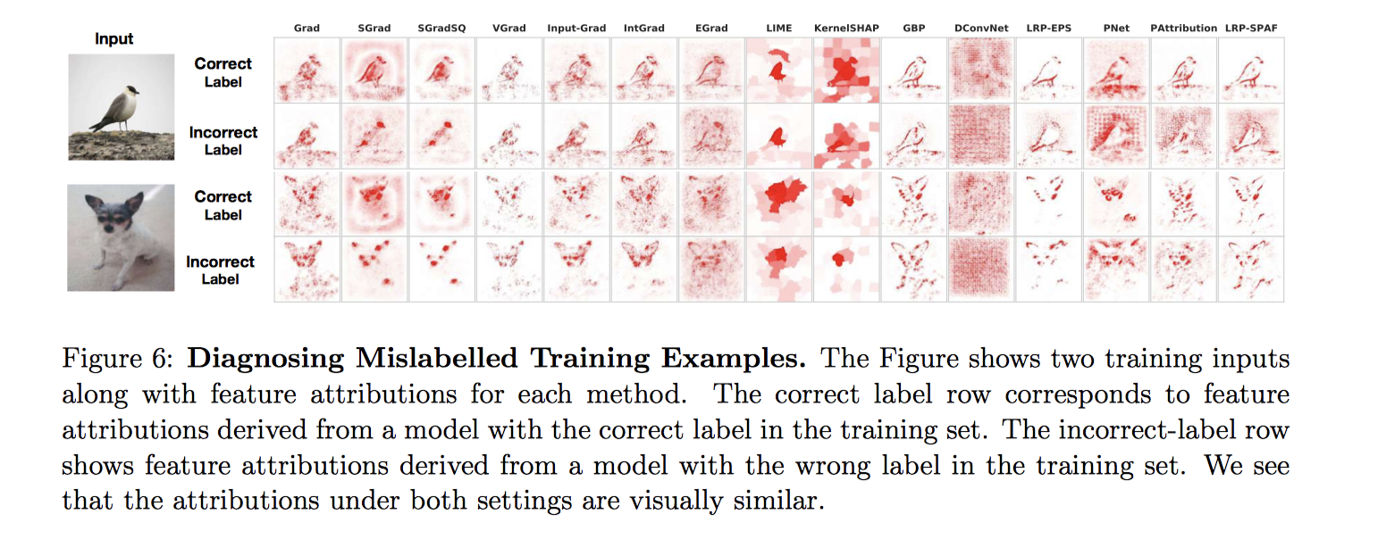
End-users reject these models mostly based on classification labels, rarely based on wrong attributions.
SSIM between the attributions of a correctly labeled instance, and the corresponding incorrectly labeled instance, are in the range 0.73 − 0.99 for all methods tested.
Mislabelled Examples

Slide 21
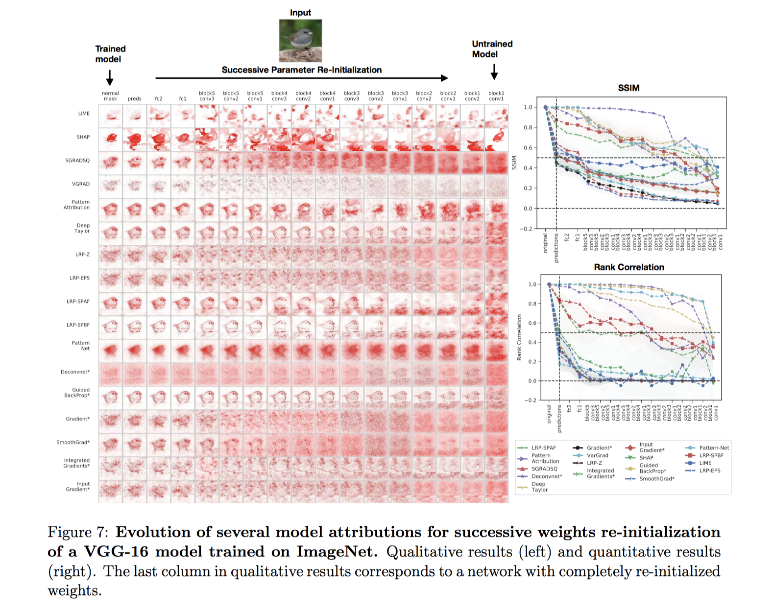
End-users reject these models mostly based on classification labels, rarely based on wrong attributions.
For signal methods,
correlation
with the original mask
is very high.
Model Contamination

Slide 22
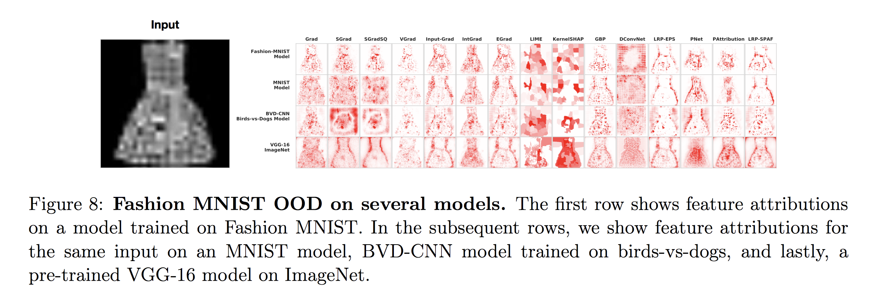
Compare attributions from an in-domain model with those derived from out-of-domain model.
Test-time Contamination

Slide 23
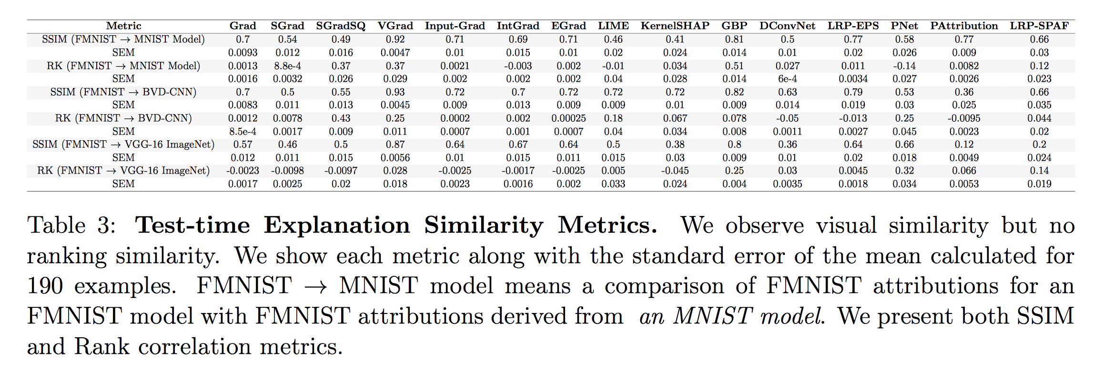
Structural similarity (visual) is very large, but rank correlations are low and widely different.
Given different “dog breed” than used during training. End-user recommendation: “NO” for wrong prediction labels. They care less about visual attributions
Test-time Contamination

Slide 24
Questions?

